Slide 1
Sergey Brin and Larry Page
Made by: Liva and Aiga

Slide 2
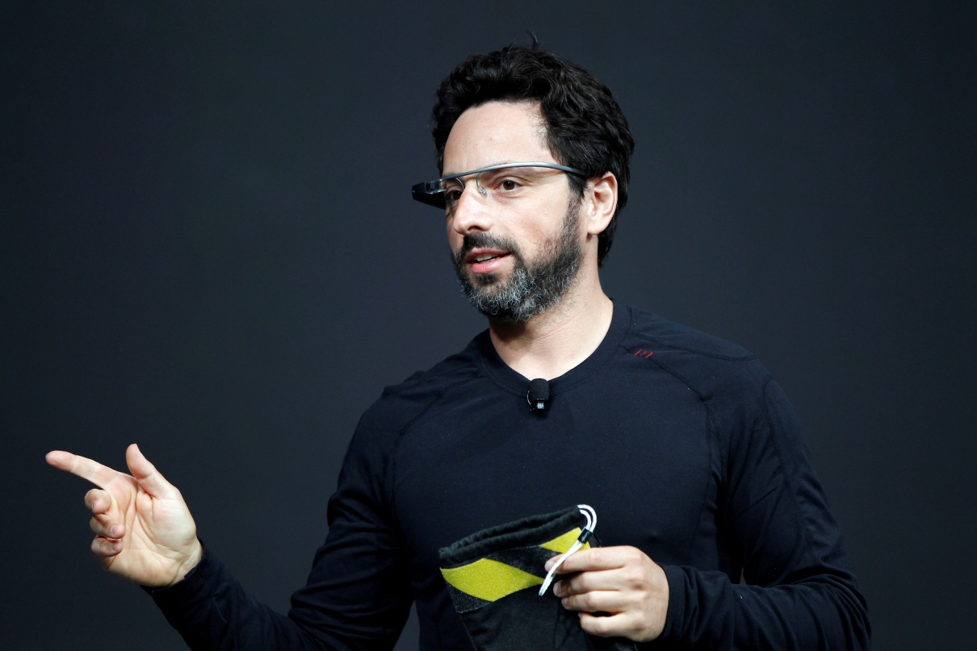
Name: Sergey Brin (42);
Nationality: American (Born in Russia, Moscow);
The main area of work: Engineer, inventor, computer programmer. Co-founded Google with Larry Page.

Slide 3
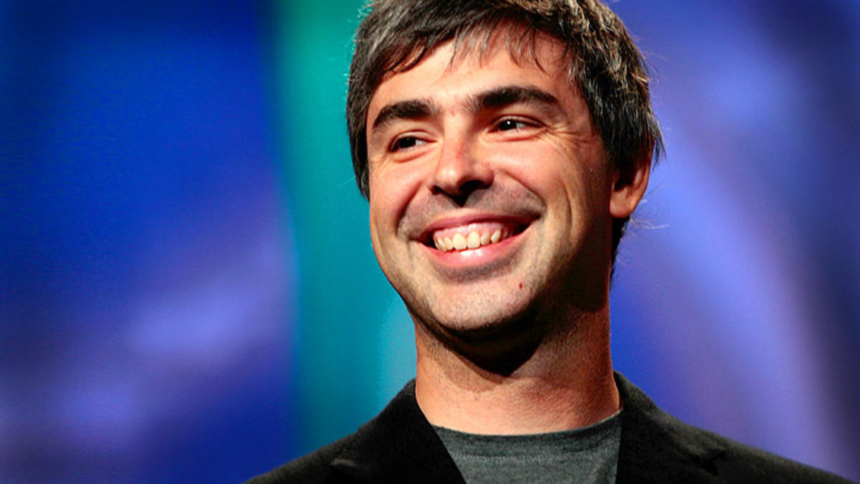
Name: Lawrence “Larry” Page (42)
Nationality: American.
The main area of work: engineer, inventor. Co-founded Google with Sergey Brin.

Slide 4
Education and door to success:
Mishkan Torah Hebrew School;
Paint Branch Montessori School in Adelphi, Maryland;
Eleanor Roosevelt High School in Greenbelt, Maryland;
University of Maryland;
Stanford University;

Slide 5
Main achievement

Slide 6
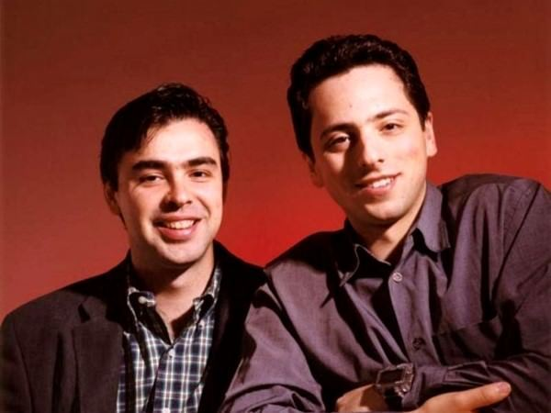
He met Larry Page and they began to work together on a research project designed to improve the methods of finding information on the Internet fundamentally.

Slide 7
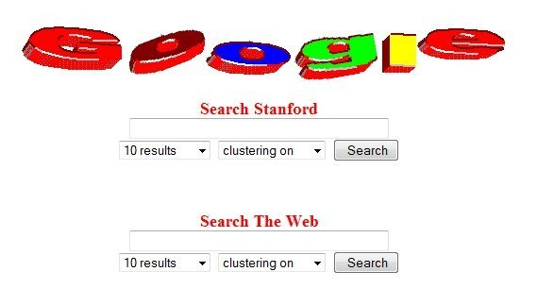

Slide 8
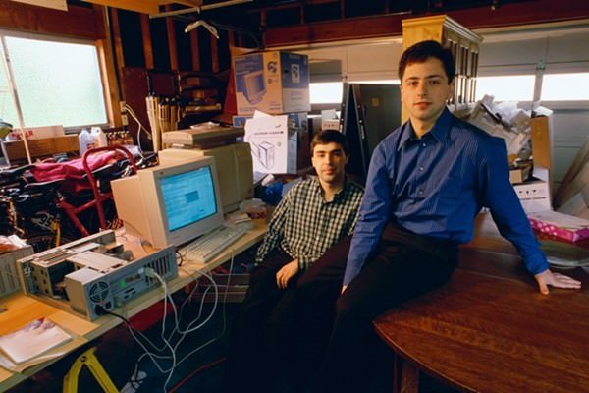
They paused their studies (1998);
Google was incorporated as a limited liability company;
Their first office was a rented garage.

Slide 9
Charity google.org

Slide 10
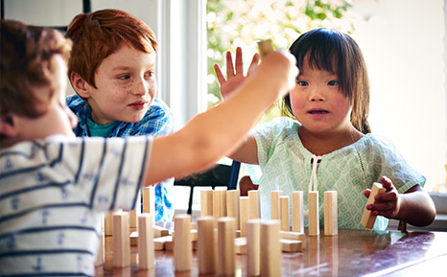
Disabilities
Their first focus aims to expand opportunity and independence for people with disabilities.

Slide 11
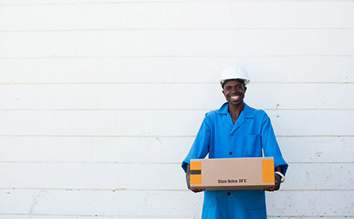
Seed Funding
Helps organizations pilot early-stage ideas that have the potential to be transformative.

Slide 12
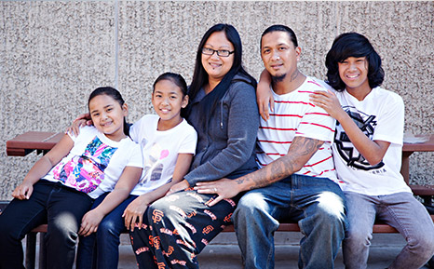
Bay Area Giving
Since 2010 they’ve given more than $100 million to local nonprofit projects.

Slide 13
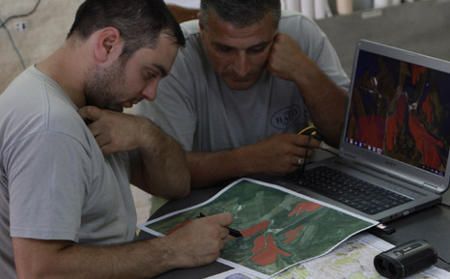
Disaster Relief
Since 2005, they’ve donated more than $9 million to relief and recovery efforts around the world.

Slide 14

Supporting the refugee and migrant crisis
€1 million to organizations who are providing front-line humanitarian relief
They matched the first €5 million in donations from the public, until together they raised an additional €10 million for relief efforts

Slide 15
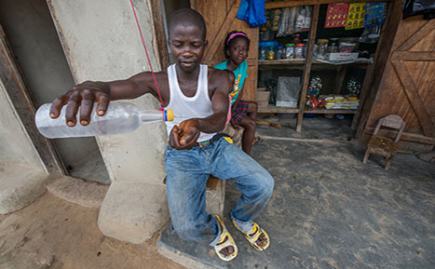
Fighting Ebola
$10 million to support nonprofits

Slide 16
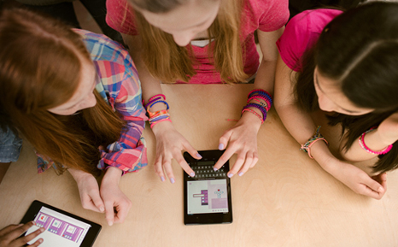
Improving computer science education
Since 2010, they’ve invested more than $40 million to expand after school coding programs, provide teacher training, offer tech resources, and facilitate global access to computer science education for next generation of tech leaders.

Slide 17

Fighting human trafficking and child abuse
Since 2010, they’ve given more than $21 million

Slide 18
Legacy

Slide 19





Slide 20
Thank you for your attention!

